Slide 1
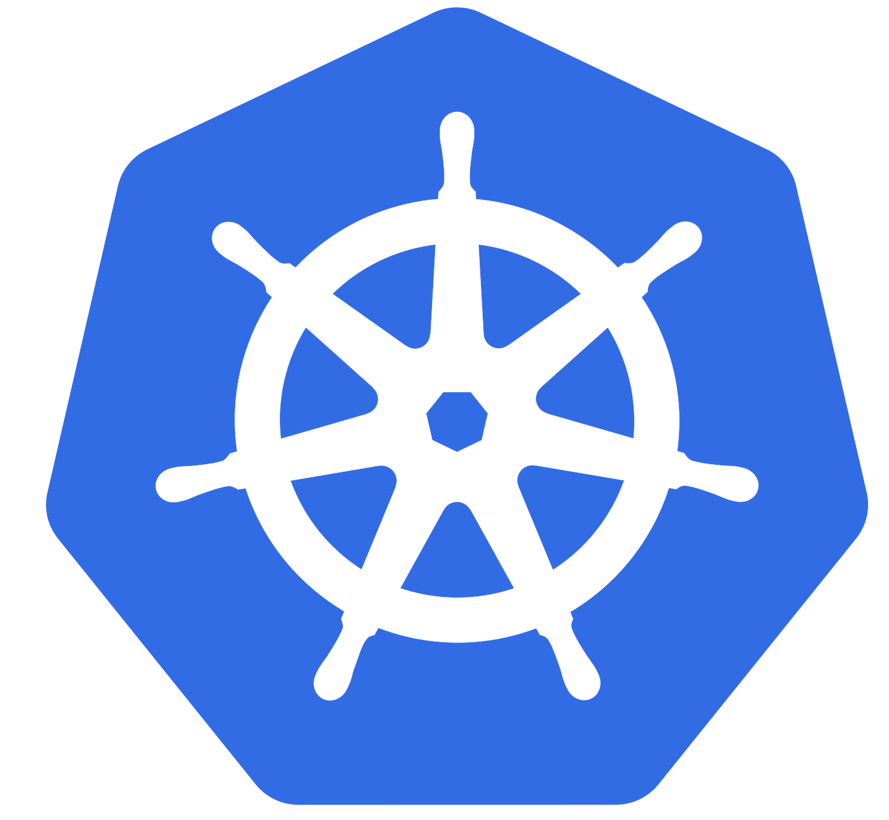



Advanced AKS Configuration
Infrastructure as Code User Group Oslo
20.04.2021
Evgeny Borzenin

Slide 2





Learn more about AKS https://aka.ms/azure-aks
Get your next Learner digital badge of Azure Heroes program https://aka.ms/digital-badge
Win a cool Microsoft backpack!
Don’t forget to add Microsoft Azure skill to your LinkedIn account to stay connected with a developer community
+ Microsoft Azure
We post the latest announces about free events for the developers in Norway on our official Twitter account
@MSDevNo

Slide 3
Infrastructure as Code User Group 2021 roadmap
AKS workshops:
[x] AKS and Kubernetes 101
[ ] Advanced AKS configuration
[ ] Implement Immutable Infrastructure on Azure with Bicep
[ ] Monitoring in AKS
[ ] Service mesh with linkerd
[ ] AKS application deployment strategy
[ ] AKS security
+ “regular” events (work in progress)
If you have any good AKS / Kubernetes / IaC story – welcome to share!

Slide 4
Practical information
Mix of slides and labs with focus on labs
I don’t have moderator
Let’s help each other, the one who finished earlier can help others
Keep the same names as in labs -> easier to troubleshot
Share your screen if you stack with some issues
Labs are available after the event

Slide 5
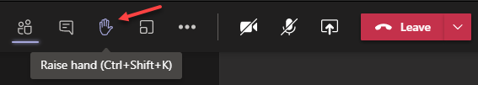
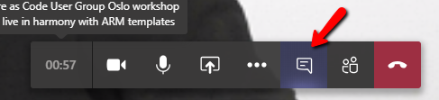

Microsoft Teams 101
Mute your mic (but don’t forget to unmute when you speak)
Feel free to use video
«Rise your hand» if you need some attention
Conversation/chat
Share screen

Slide 6
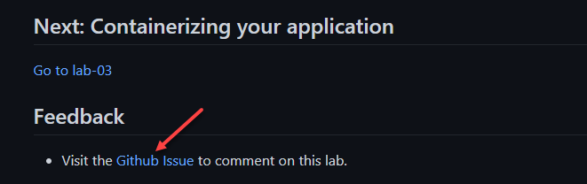
Practical information
Each lab is time-boxed (ish…)
When you completed a lab, please post to the Conversation channel
lab-01 (lab-02, lab-03 etc…)
Feel free to contribute to the labs content by fixing gramma, typos, wrong commands etc..
Feel free to comment on each lab

Slide 7












Workshop use-case
AKS in private VNet
Use APIM to expos APIs
AAD RBAC
Monitoring with Log Analytics and AppInsights
API Management
(External)
APIM subnet
APIM VNet
Monitor
VNet peering
Nginx Ingress
controller (SLB)
Public IP
Prefix
System
Nodepool
Workload
Nodepool
AKS subnet
AKS VNet
pull
KeyVault
egress IP
Container Registry

Slide 8



Infrastructure
iac-ws2-base-rg
API Management
(External)
Container Registry
apim-net
Log Analytics
Public IP
Prefix
Application Insights
iac-ws2-vnet

Slide 9

Infrastructure
iac-ws2-base-rg
API Management
(External)
Container Registry
apim-net
Log Analytics
Public IP
Prefix
Application Insights
iac-ws2-vnet
VNet peering
iac-ws2-aks-blue-rg
iac-ws2-blue-aks
iac-ws2-aks-blue-mi
aks-net
iac-ws2-aks-blue-vnet

Slide 10
AKS cluster design considerations

Slide 11
Cluster design
Number of clusters / environment
Networking
Resource planning
Nodes size considerations
RBAC
Monitoring

Slide 12
AKS configuration options
Networking basic vs advanced
Network capacity planning
Integration with AAD
Monitoring with Log Analytics

Slide 13
Lab 02 – 15 min

Slide 14
guinea pig apps walk through

Slide 15
Lab-03 – 15 min

Slide 16
AKS node pools

Slide 17
AKS node pools
System vs User node pools
Node pools use-cases
spot node pool
Assigning Pods to Nodes
Taints and Tolerations

Slide 18
Lab 04

Slide 19
Pod managed identities

Slide 20
Pod managed identities

Slide 21
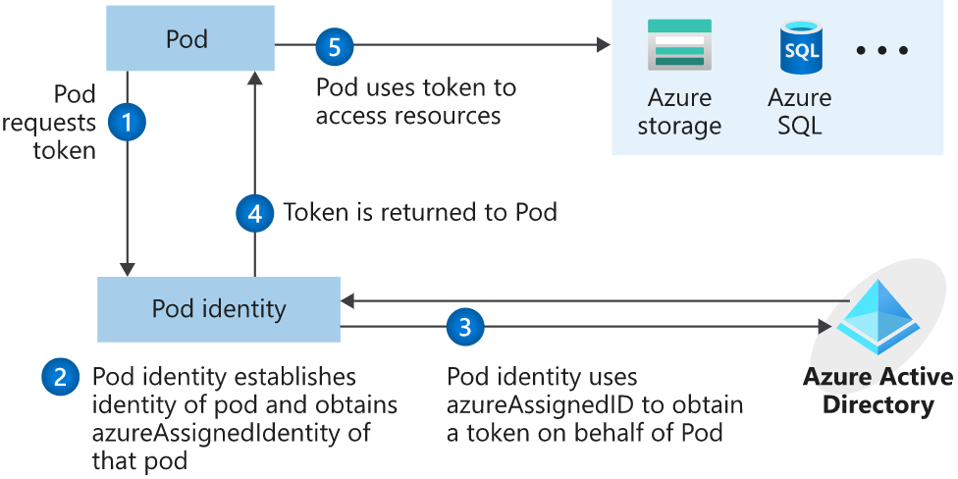
Pod managed identities

Slide 22
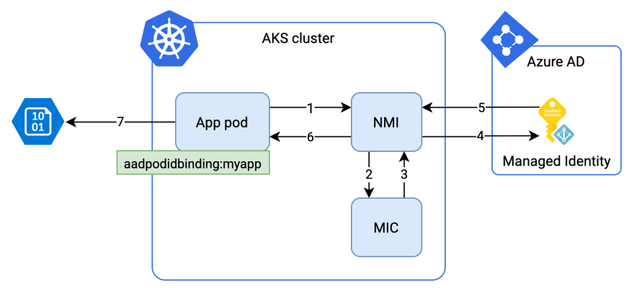
Pod managed identities

Slide 23
Lab 05 – 20 min

Slide 24
NGINX ingress controller

Slide 25
Lab 06 – 20 min

Slide 26
API Management 101

Slide 27
APIM connectivity
GET https://iac-ws2-evg-apim.azure-api.net/api-b/api HTTP/1.1
API Management
(External)
apim-net
iac-ws2-vnet
iac-ws2-base-rg
GET http://10.11.0.146/api
VNet peering
NGINX Ingress
controller
GET http://api-b-service:8081/api
api-b-service
pod
pod
pod
api-b
api-b
api-b
aks-net
iac-ws2-aks-blue-vnet
iac-ws2-aks-blue-rg

Slide 28
Lab 07 – 15 min

Slide 29
AKS egress options

Slide 30
Lab 08 – 15 min

Slide 31
Resource management

Slide 32
Lab 09 – 15 min

